Slide 1

13th International Conference on Computer and Knowledge Engineering
(ICCKE2023)

Slide 2
Theophilus Ebuka Odoh
A Survey of the AVOA Metaheuristic Algorithm and its Suitability for Power System Optimization and Damping Controller Design

Slide 3
OUTLINE OF THE PRESENTATION
Introduction
Problem statement
Aim and Objectives
Methodology
Results
Contribution to knowledge
Conclusion
Recommendations
References

Slide 4
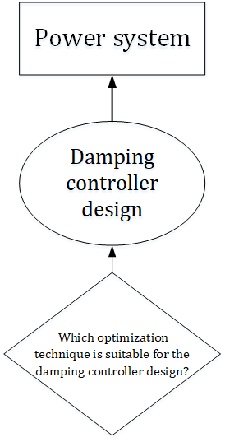
INTRODUCTION
Oscillation in the power system is a major problem to the stable operation of the power system
Damping controllers are applied to damp these oscillations
Design of damping controllers requires optimization techniques
Choosing an optimization algorithm

Slide 5
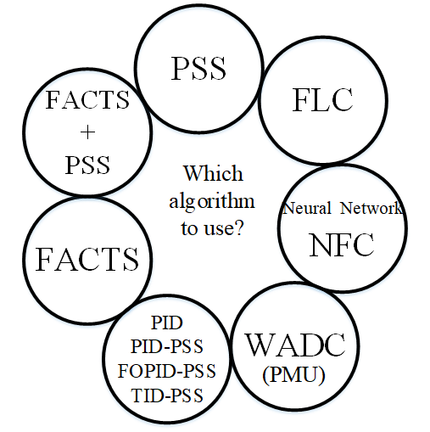
Problem Statement

Slide 6
Aim and Objectives
The aim of this research, was to survey the suitability of African vulture optimization algorithm (AVOA) for damping controller design in the power system.
The research aim was achieved through the following objectives
Reviewing areas where AVOA has been used for optimization problem in the power system
Assessing the AVOA performance in the identified areas above
Drawing a conclusion based on AVOA performance.

Slide 7
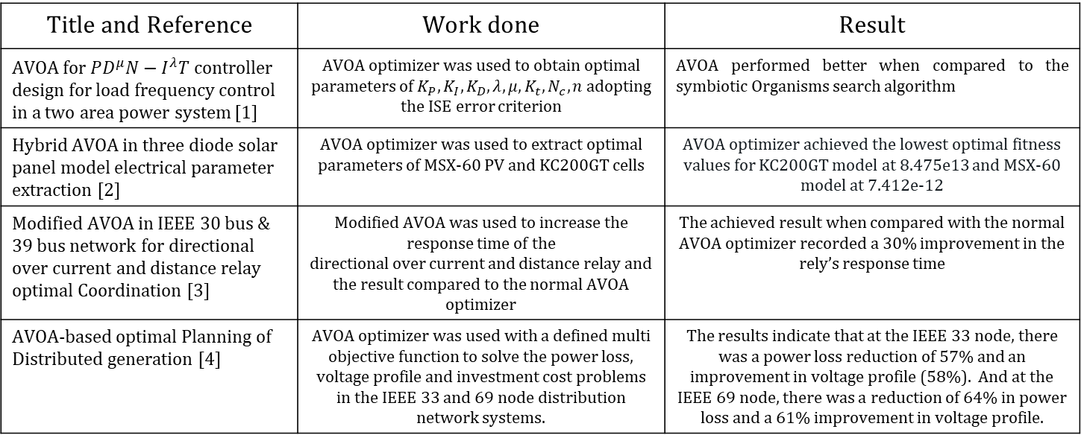
Methodology
Title and Reference | Work done | Result
AVOA for ${PD}^{μ}N−I^{λ}T$controller design for load frequency control in a two area power system [1] | AVOA optimizer was used to obtain optimal parameters of $K_{P}, K_{I}, K_{D}, λ, μ, K_{t}, N_{c}, n$adopting the ISE error criterion | AVOA performed better when compared to the symbiotic Organisms search algorithm
Hybrid AVOA in three diode solar panel model electrical parameter extraction [2] | AVOA optimizer was used to extract optimal parameters of MSX-60 PV and KC200GT cells | AVOA optimizer achieved the lowest optimal fitness values for KC200GT model at 8.475e13 and MSX-60 model at 7.412e-12
Modified AVOA in IEEE 30 bus & 39 bus network for directional over current and distance relay optimal Coordination [3] | Modified AVOA was used to increase the response time of the directional over current and distance relay and the result compared to the normal AVOA optimizer | The achieved result when compared with the normal AVOA optimizer recorded a 30% improvement in the rely’s response time
AVOA-based optimal Planning of Distributed generation [4] | AVOA optimizer was used with a defined multi objective function to solve the power loss, voltage profile and investment cost problems in the IEEE 33 and 69 node distribution network systems. | The results indicate that at the IEEE 33 node, there was a power loss reduction of 57% and an improvement in voltage profile (58%). And at the IEEE 69 node, there was a reduction of 64% in power loss and a 61% improvement in voltage profile.

Slide 8
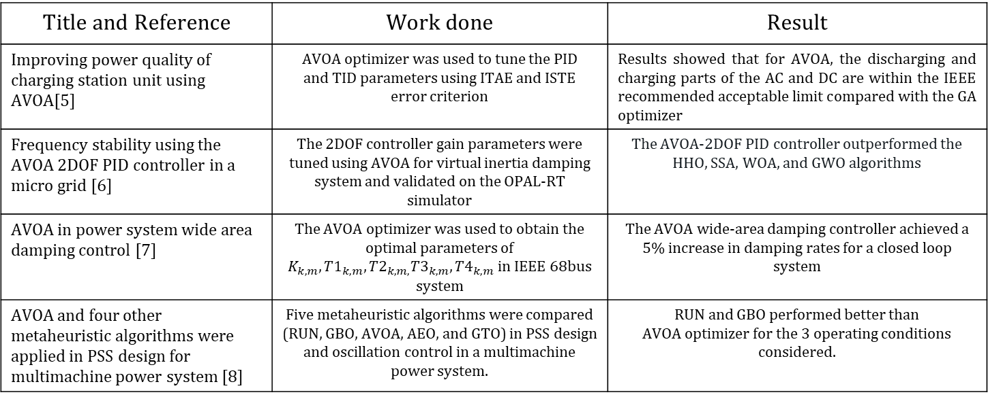
Title and Reference | Work done | Result
Improving power quality of charging station unit using AVOA[5] | AVOA optimizer was used to tune the PID and TID parameters using ITAE and ISTE error criterion | Results showed that for AVOA, the discharging and charging parts of the AC and DC are within the IEEE recommended acceptable limit compared with the GA optimizer
Frequency stability using the AVOA 2DOF PID controller in a micro grid [6] | The 2DOF controller gain parameters were tuned using AVOA for virtual inertia damping system and validated on the OPAL-RT simulator | The AVOA-2DOF PID controller outperformed the HHO, SSA, WOA, and GWO algorithms
AVOA in power system wide area damping control [7] | The AVOA optimizer was used to obtain the optimal parameters of $K_{k,m},{T1}_{k,m},{T2}_{k,m,}{T3}_{k,m},{T4}_{k,m}$ in IEEE 68bus system | The AVOA wide-area damping controller achieved a 5% increase in damping rates for a closed loop system
AVOA and four other metaheuristic algorithms were applied in PSS design for multimachine power system [8] | Five metaheuristic algorithms were compared (RUN, GBO, AVOA, AEO, and GTO) in PSS design and oscillation control in a multimachine power system. | RUN and GBO performed better than AVOA optimizer for the 3 operating conditions considered.

Slide 9
AVOA
AVOA is a meta-heuristic algorithm which mimics the African vultures behaviour
The AVOA also demonstrates exploration and exploitation ability in its algorithm
This research implements the AVOA in PSS damping controller design
Flow chart of the AVOA Process

Slide 10
Contribution to knowledge
This present study recommends an optimization algorithm for power system optimization and damping controller design.

Slide 11
Conclusion
This study has presented a thorough survey of the AVOA application in power system optimization problems and damping controller design. The study identified 22 articles where AVOA has been used for power system optimization problems and damping controller design, specifically for damping controller design AVOA was used in [11] for wide-area damping controller design and it achieved a 5% increase in damping rates for the closed-loop system, AVOA was used in [37] for PSS design and only Runge Kutta optimizer (RUN) and Gradient-based optimization (GBO) outperformed the AVOA optimizer

Slide 12
Recommendations
Based on the survey, AVOA is recommended as a good optimizer for power system optimization problems and damping controller designs.

Slide 13
References
[1] M. Ahmed, M. Khamies, G. Magdy, and S. Kamel, “Designing Optimal PD N − I T Controller for LFC of Two-area Power Systems Using African Vulture ’ s Optimization Algorithm,” 2021 22nd Int. Middle East Power Syst. Conf., pp. 430–437, 2021, doi: 10.1109/MEPCON50283.2021.9686297.
[2] M. A. Soliman, H. M. Hasanien, R. A. Turky, and S. M. Muyeen, “Hybrid African vultures–grey wolf optimizer approach for electrical parameters extraction of solar panel models,” Energy Reports, vol. 8, pp. 14888–14900, 2022.
[3] A. Korashy, S. Kamel, F. Jurado, and M. Eslami, “Optimal coordination of distance relays and non-standard characteristics for directional overcurrent relays using a modified African vultures optimization algorithm”, IET Generation, Transmission & Distribution, vol 17 (11) pp. 2497-2522 doi: 10.1049/gtd2.12833.
[4] M. Zhao, J. Huan, X. Huang, T. Yu, and Q. Ding, “Optimal Planning of Distributed Generation Based on African Vultures Optimization Algorithm,” 2022 IEEE 6th Conf. Energy Internet Energy Syst. Integr., pp. 611–616, 2022, doi: 10.1109/EI256261.2022.10116298.
[5] S. M. A. Altbawi, S. A. Khalid., A. S. Mokhtar., R. H. Alsisi., Z. A. Arfeen., H. Shareef., and M. Kausar “Improve power quality of charging station unit using African vulture optimization algorithm,” Institute of Advanced Engineering and Science (IAES) vol. 12, no. 5, pp. 2605–2614, 2023, doi: 10.11591/eei.v12i5.5717.

Slide 14
[6] N. Swain, N. Sinha, and S. Behera, “Stabilized frequency response of a microgrid using a two-degree-of-freedom controller with African vultures optimization algorithm,” ISA Trans., 2023, doi: 10.1016/j.isatra.2023.05.009.
[7] M. E. C. Bento, “Design of a Resilient Wide-Area Damping Controller Using African Vultures Optimization Algorithm,” Proc. 2021 31st Australas. Univ. Power Eng. Conf. AUPEC 2021, 2021, doi: 10.1109/AUPEC52110.2021.9597758.
[8] A. Sabo, T. E. Odoh, H. Shahinzadeh, Z. Azimi, and M. Moazzami, “Implementing Optimization Techniques in PSS Design for Multi-Machine Smart Power Systems: A Comparative Study,” Energies, vol. 16, no. 5, p. 2465, 2023.

